Slide 1
Lecture 15: IP addressing
(Revisited)

Slide 2
Octets
The 32-bit IP address is broken up into 4 octets, which are arranged into a dotted-decimal notation scheme.
An octet is a set of 8 bits & not a musical instrument.
Example of an IP version 4:
172.64.126.52

Slide 3
Converting to Decimal
You’ll need to convert binary to decimal & vice versa to compute subnets & hosts.
So, it’s time for a quick review lesson in binary-to-decimal conversion.
There are 8 bits in an octet & each bit can only be a 1 or a 0.

Slide 4
Converting to Decimal (Cont.)
What then do you suppose is the largest decimal number that can be expressed in an octet?
Eight 1’s (1111 1111)

Slide 5
IP Address Classes
IP addresses are divided into 5 classes, each of which is designated with the alphabetic letters A to E.
Class D addresses are used for multicasting.
Class E addresses are reserved for testing & future use.

Slide 6
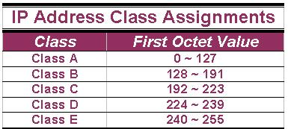
IP Address Classes (Cont.)
The 5 IP classes are split up based on the value in the 1st octet:

Slide 7
IP Address Classes (Cont.)
Using the ranges, you can determine the class of an address from its 1st octet value.
An address beginning with 120 is a Class A address, 155 is a Class B address & 220 is a Class C address.

Slide 8
Are You the Host or the Network?
The 32 bits of the IP address are divided into Network & Host portions, with the octets assigned as a part of one or the other.
Network & Host Representation
By IP Address Class
Class
Octet1
Octet2
Octet3
Octet4
Class A
Network
Host
Host
Host
Class B
Network
Network
Host
Host
Class C
Network
Network
Network
Host

Slide 9
Are You the Host or the Network? (Cont.)
Each Network is assigned a network address & every device or interface (such as a router port) on the network is assigned a host address.
There are only 2 specific rules that govern the value of the address.

Slide 10
Are You the Host or the Network? (Cont.)
A host address cannot be designated by all zeros or all ones.
These are special addresses that are reserved for special purposes.

Slide 11
Class A Addresses
Class A IP addresses use the 1st 8 bits (1st Octet) to designate the Network address.
The 1st bit which is always a 0, is used to indicate the address as a Class A address & the remaining 7 bits are used to designate the Network.
The other 3 octets contain the Host address.

Slide 12
Class A Addresses (Cont.)
There are 128 Class A Network Addresses, but because addresses with all zeros aren’t used & address 127 is a special purpose address, 126 Class A Networks are available.

Slide 13
Class A Addresses (Cont.)
There are 16,777,214 Host addresses available in a Class A address.
Rather than remembering this number exactly, you can use the following formula to compute the number of hosts available in any of the class addresses, where “^{n}” represents the number of bits in the host portion:
(2^{n} – 2) = Number of available hosts

Slide 14
Class A Addresses (Cont.)
For a Class A network, there are:
2²⁴ – 2 or 16,777,214 hosts.
Half of all IP addresses are Class A addresses.
You can use the same formula to determine the number of Networks in an address class.
Eg., a Class A address uses 7 bits to designate the network, so (2⁷ – 2) = 126 or there can be 126 Class A Networks.

Slide 15
Class B IP Addresses
Class B addresses use the 1st 16 bits (two octets) for the Network address.
The last 2 octets are used for the Host address.
The 1st 2 bit, which are always 10, designate the address as a Class B address & 14 bits are used to designate the Network. This leaves 16 bits (two octets) to designate the Hosts.

Slide 16
Class B IP Addresses (Cont.)
So how many Class B Networks can there be?
Using our formula, (2¹⁴ – 2), there can be 16,382 Class B Networks & each Network can have (2¹⁶ – 2) Hosts, or 65,534 Hosts.

Slide 17
Class C IP Addresses
Class C addresses use the 1st 24 bits (three octets) for the Network address & only the last octet for Host addresses.the 1st 3 bits of all class C addresses are set to 110, leaving 21 bits for the Network address, which means there can be 2,097,150 (2²¹ – 2) Class C Networks, but only 254 (2⁸ – 2) Hosts per Network.

Slide 18
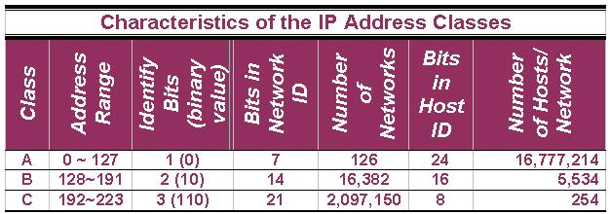
Class C IP Addresses (Cont.)

Slide 19
Special Addresses
A few addresses are set aside for specific purposes.
Network addresses that are all binary zeros, all binary ones & Network addresses beginning with 127 are special Network addresses.

Slide 20
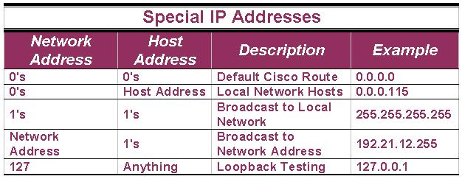
Special Addresses (Cont.)

Slide 21
Special Addresses (Cont.)
Within each address class is a set of addresses that are set aside for use in local networks sitting behind a firewall or NAT (Network Address Translation) device or Networks not connected to the Internet.

Slide 22
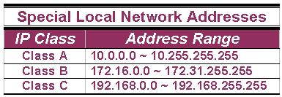
Special Addresses (Cont.)
A list of these addresses for each IP address class:

Slide 23
Credit:
peter.joseph.smith@tafensw.edu.au

